Slide 1

Time Series Modeling
Thomas O’Gara

Slide 2
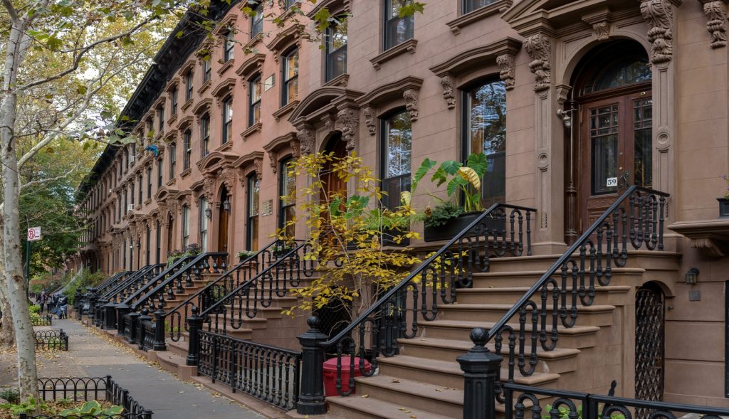
Deliverable
What are the 5 best Zip Codes for a real estate investment fund to invest in within the US?
Notes:
Recommendation is focused on profit margins, risk?
What time horizon are you predicting against?
How far back are you back testing data to forecast into the future?

Slide 3
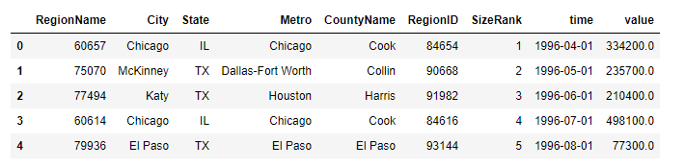
Data Set
Zillow Research Page:
https://www.zillow.com/research/data/
Monthly average home value in each Zip Code across the country from 1996-2018

Slide 4
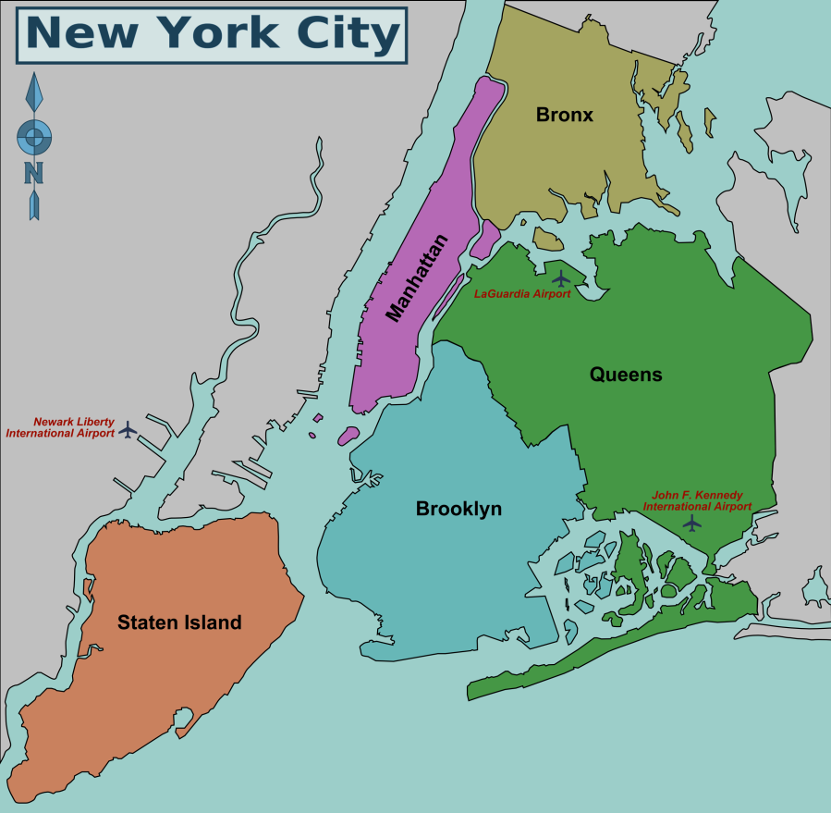
Narrowed down data
Explored 5 NYC boroughs – contains hundreds of Zip Codes

Slide 5
What is our investor’s goal?
Best absolute return on a percentage basis for the next 5 to 10 years
Not concerned with volatility month/month
Protection against large downturns (aka 2000, 2008 busts)

Slide 6
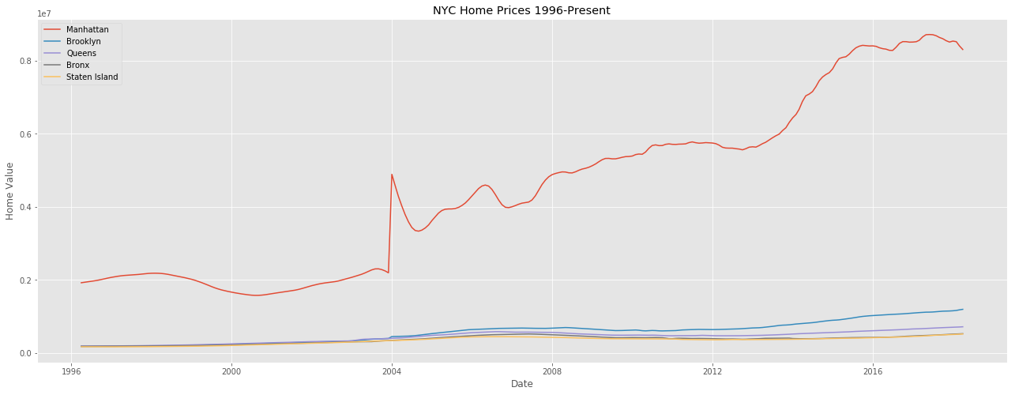
Which NYC borough to invest in?

Slide 7
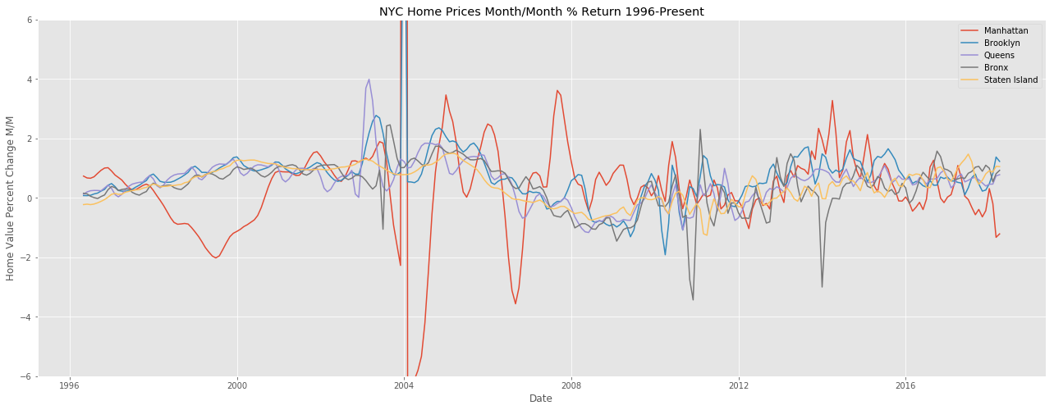
Month over month % return

Slide 8
Manhattan Zip Codes to explore
10011
10128
10021
10014
11106 (not Manhattan*)
11231 (not Manhattan*)

Slide 9
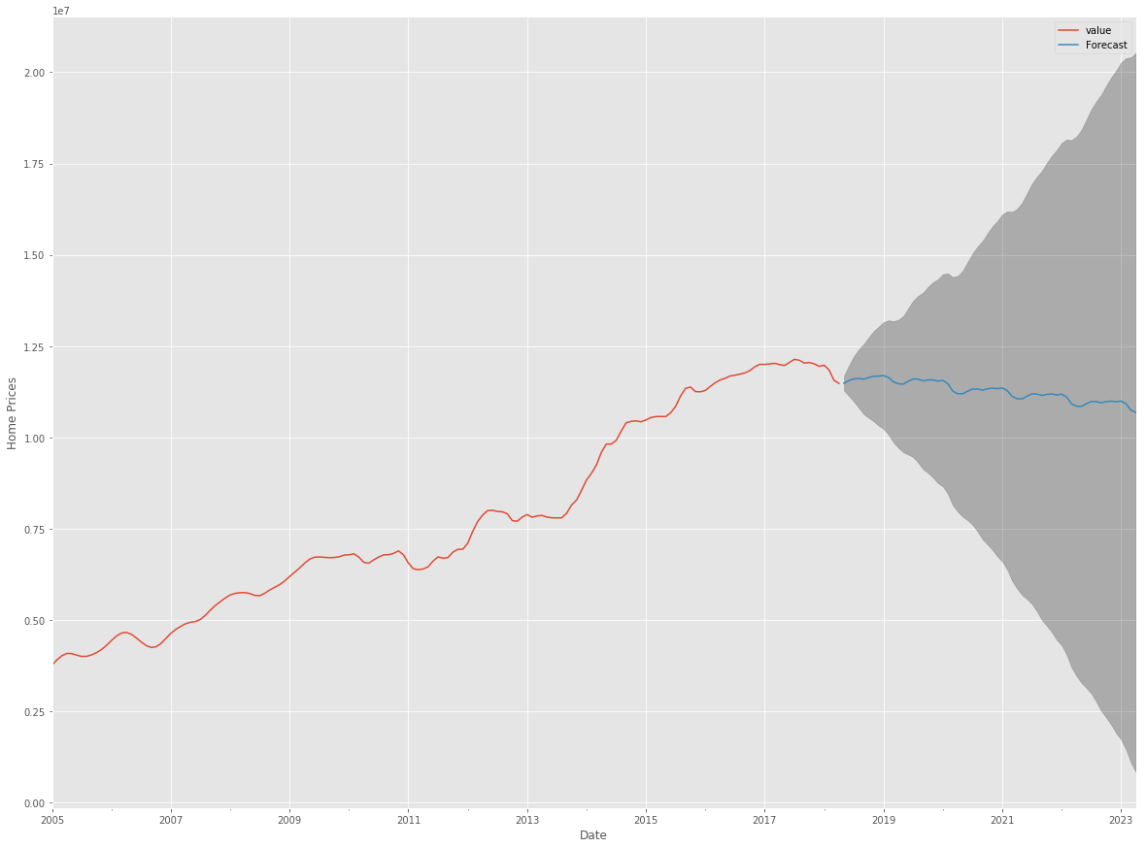
10011 forecast

Slide 10
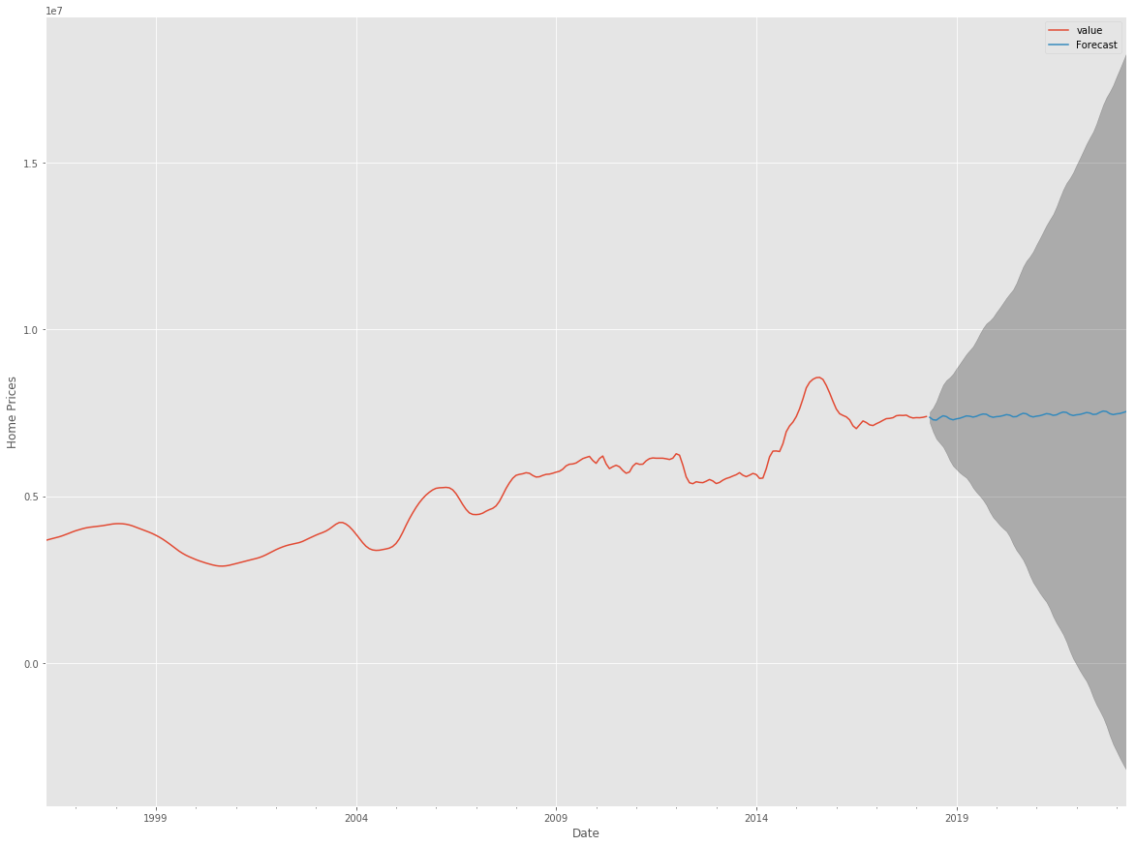
10128 forecast

Slide 11
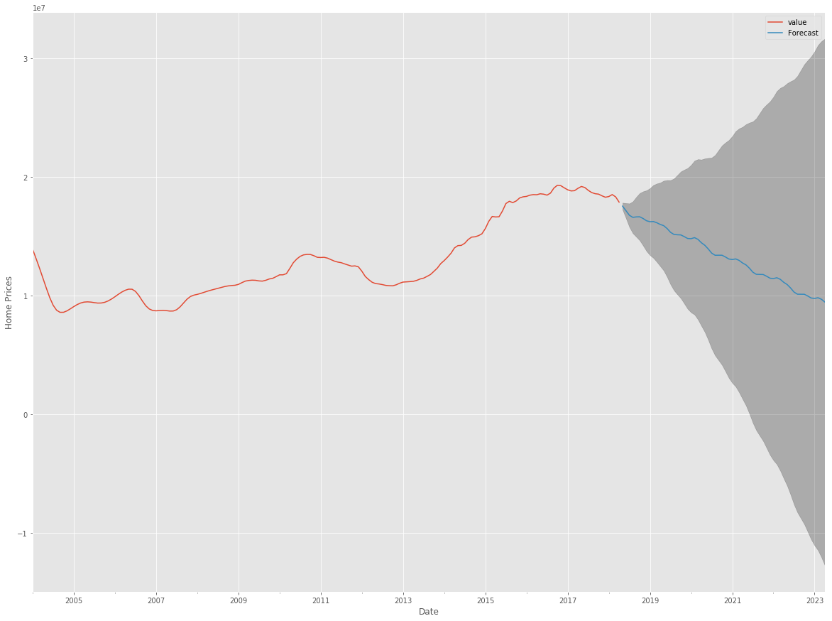
10021 forecast

Slide 12
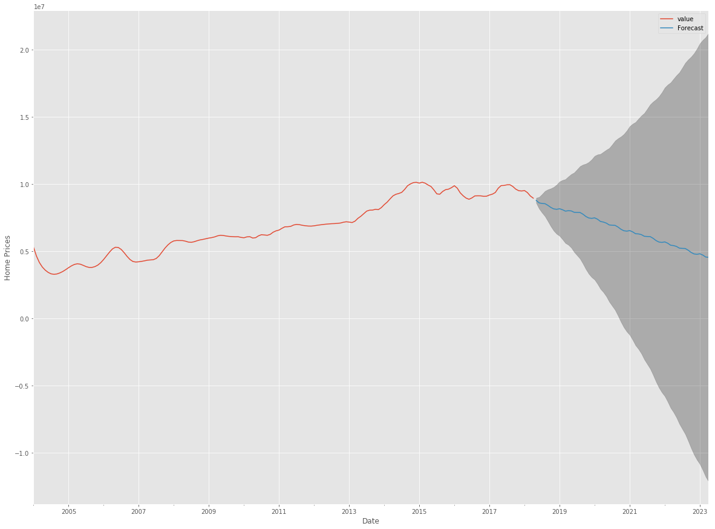
10014 forecast

Slide 13
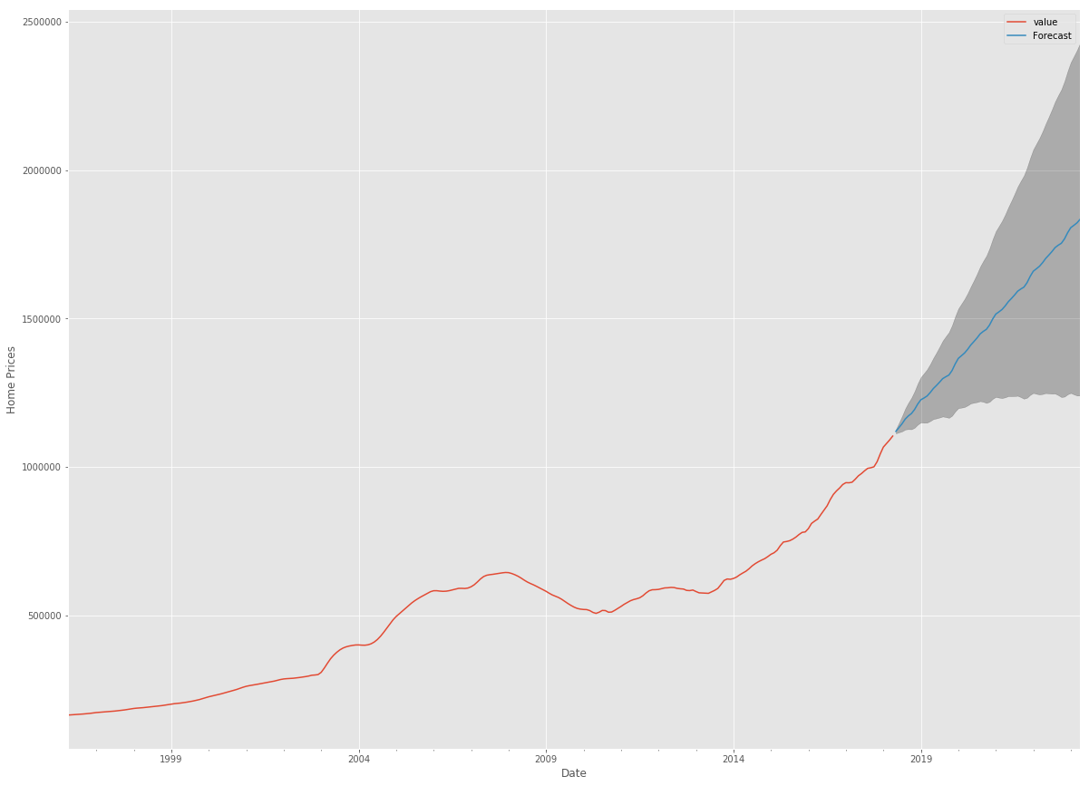
11106 forecast

Slide 14
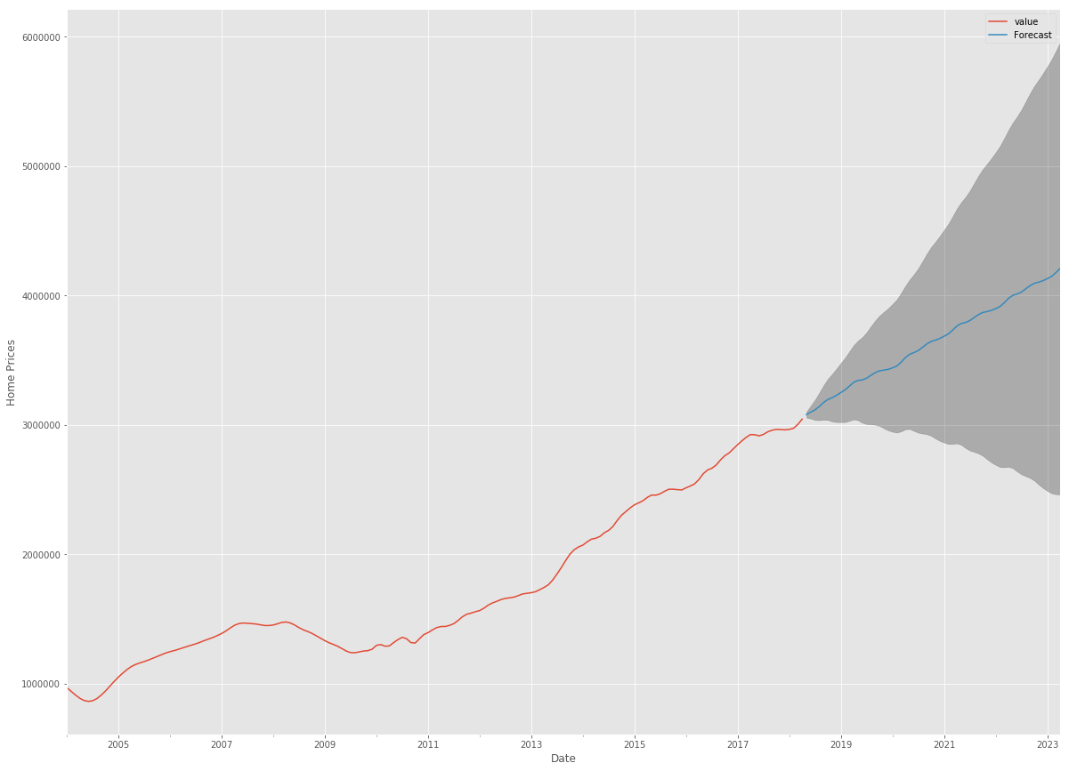
11231 forecast

Slide 15
Recommendation
Focus investment on 11106 and 11231
Model refinement for more accurate predictions

Slide 16
Questions?
???

